Slide 1
Implementing with Machine Learning
Geoff Hulten

Slide 2
Machine Learning in an Application
model.load(<dataFile>)
for each interaction:
context =
GetRawContext(<userInput>, <programState>, …)
x = Featurize(context)
y = model.predict( [ x ] )
UpdateUserExperience( y[0] )
File Format: <$t$>, <$n$>, <$w_{0}$>, <$w_{1}$>, … < $w_{n}$>
Context: [ <message text>, <metadata> ]
Features: <exactly same code from training>
Inference Code: <engine to execute the model>
User Experience:
if y == 0:
AddToInbox(newMessage)
else:
pass

Slide 3
Simple Implementation
Intelligence Creation Environment
Intelligent Runtime
Build the model
Save out model (parameters)
Export feature creation code
Integrate feature creation code
Load model (parameters)
Program state -> Context
Inference Engine
Featurize, call model
Update the user experience
Challenges
Feature code implementation Explore vs Perform
Updating model regularly
Keeping things in sync
Knowing when there are problems

Slide 4
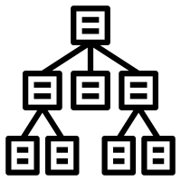
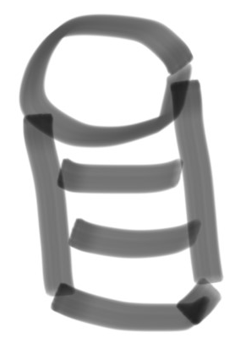



Components of an Implementation
Intelligence Management
Verify new intelligence
Control rollouts:
Keep in sync
Clients/services
Support online evaluation
Intelligence Creation Environment
Intelligence Runtime
Intelligence Orchestration
Monitoring success
Inspect Interactions
Adapt as things change
Deal with mistakes
Updating thresholds
Drive the racecar
Program State -> Context
Execute Feature Code
Execute Model
Interpret Model Output
Control User Experience
Update:
Models
Feature Code
Telemetry -> Context
Feature code in sync
Computation & Data
All the training stuff…
Telemetry
Verifying outcomes
Training data
Selecting what to observe
Sampling
Summarizing

